Slide 1
Into the Word
Word Inspired

Slide 2
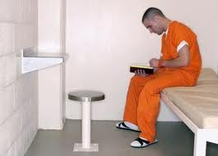

Slide 3
¹⁶ All Scripture is God-breathed and is useful for teaching, rebuking, correcting and training in righteousness, ¹⁷ so that the servant of God may be thoroughly equipped for every good work.
2 Timothy 3:16-17

Slide 4
Challenge:
Be inspired by the inspired Word of God that you experience transformation.

Slide 5
Inspired

Slide 6
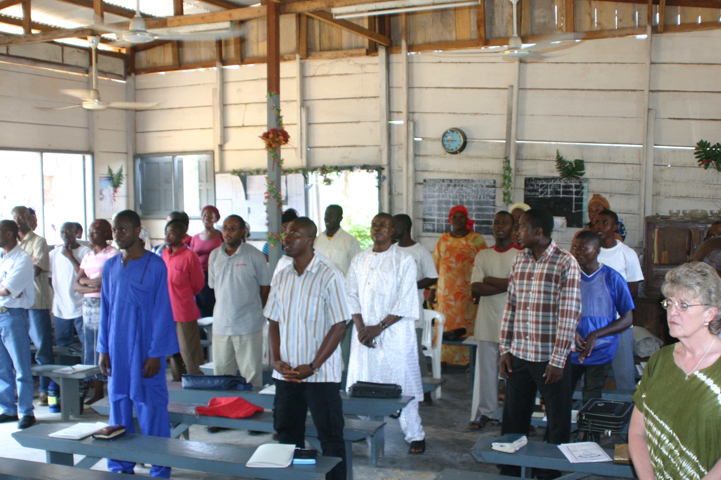
Teaching

Slide 7
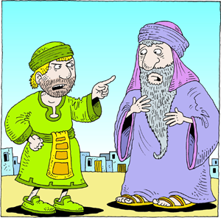
Rebuking
ChristArt.com

Slide 8
Correcting

Slide 9
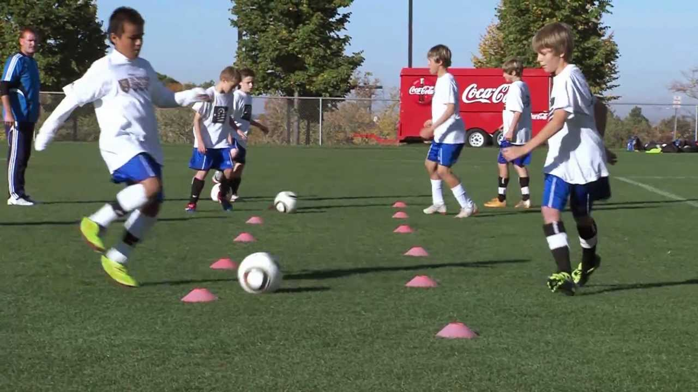
Training in Righteousness

Slide 10
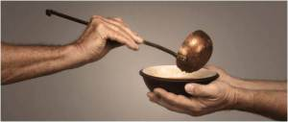
Result: Good Works

Slide 11
Our Response
Study the Word
Reflect on the Word
Apply the Word

Slide 12
Be inspired by the inspired Word of God that you may experience transformation and be an agent of transformation.

