Slide 1
Jesus
Worthy of Praise

Slide 2
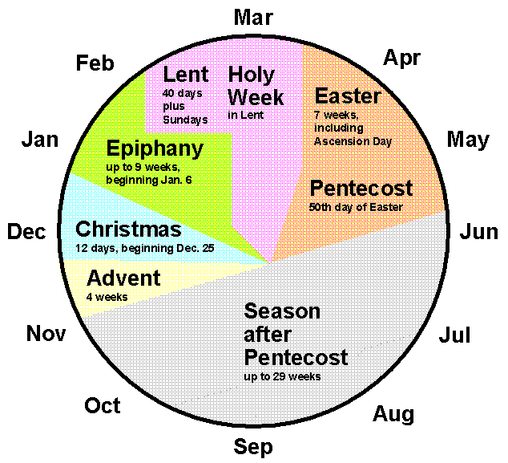

Slide 4
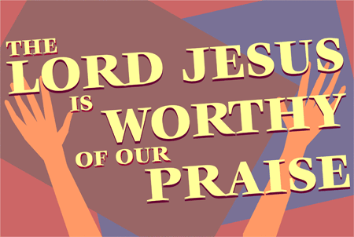

Slide 5
¹¹ Then I looked and heard the voice of many angels, numbering thousands upon thousands, and ten thousand times ten thousand. They encircled the throne and the living creatures and the elders. ¹² In a loud voice they were saying:
“Worthy is the Lamb, who was slain,
to receive power and wealth and wisdom and strength
and honor and glory and praise!”

Slide 6
¹³ Then I heard every creature in heaven and on earth and under the earth and on the sea, and all that is in them, saying:
“To him who sits on the throne and to the Lamb
be praise and honor and glory and power,
for ever and ever!”
¹⁴ The four living creatures said, “Amen,” and the elders fell down and worshiped.

Slide 7
Context

Slide 8
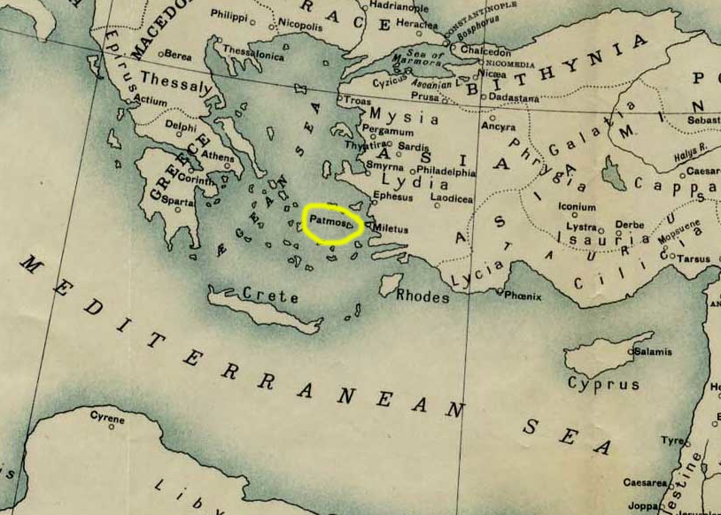

Slide 9
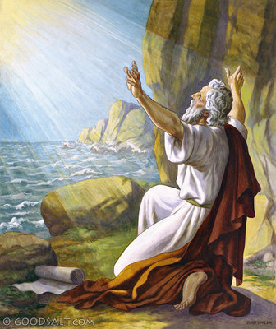

Slide 10
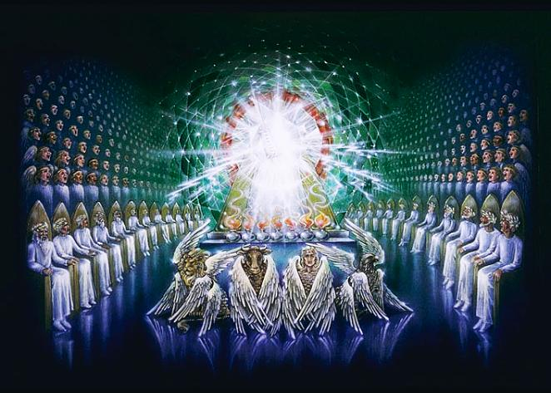

Slide 11
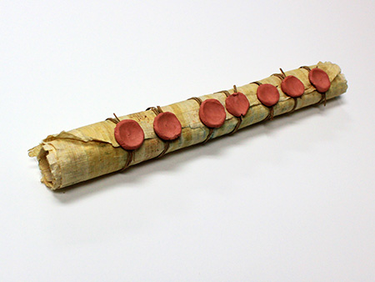

Slide 12
Multitudes of Praise

Slide 13
¹¹ Then I looked and heard the voice of many angels, numbering thousands upon thousands, and ten thousand times ten thousand. They encircled the throne and the living creatures and the elders. . .
¹³ Then I heard every creature in heaven and on earth and under the earth and on the sea, and all that is in them, saying:

Slide 14
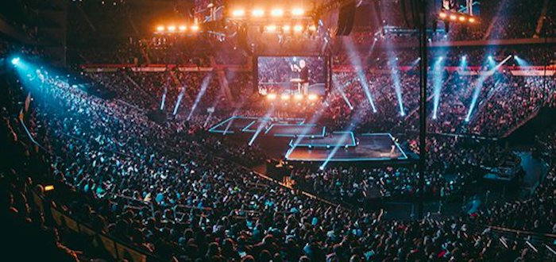

Slide 15
Worthy is the Lamb

Slide 16
“Worthy is the Lamb, who was slain,
to receive power and wealth and wisdom and strength
and honor and glory and praise!”

Slide 18
The Lamb remains always the crucified one, even when he is also the resurrected one and the Lord of the world. There is no path to worthiness -- just as there is no road to Easter -- that does not pass through the cross.
Dr. Walter F. Taylor, Jr.

Slide 19
“Worthy is the Lamb, who was slain,
to receive power and wealth and wisdom and strength
and honor and glory and praise!”

Slide 20
Worship the King

Slide 21
“To him who sits on the throne and to the Lamb
be praise and honor and glory and power,
for ever and ever!”

Slide 23
“To him who sits on the throne and to the Lamb
be praise and honor and glory and power,
for ever and ever!”

Slide 24
Lessons for Disciples

Slide 25
¹⁴ The four living creatures said, “Amen,” and the elders fell down and worshiped.

Slide 26
